Slide 1




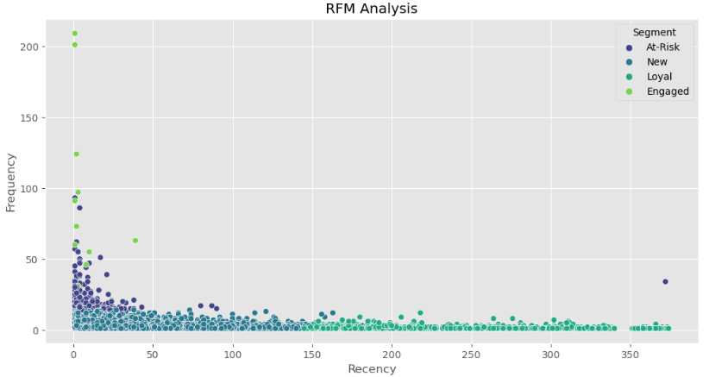
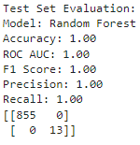
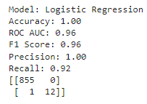
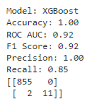
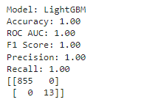
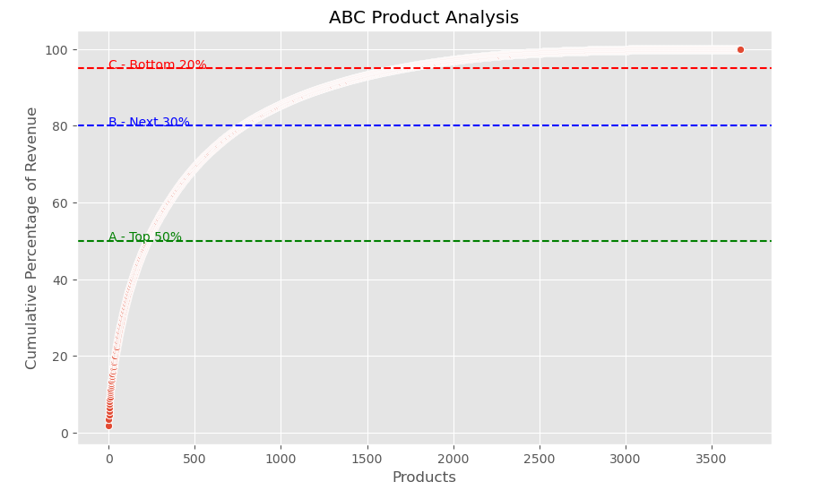
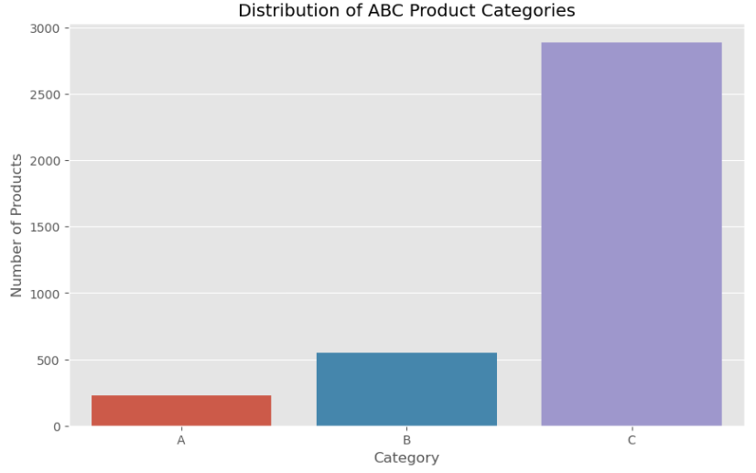
Market MinderPredictive Analytics for Enhanced Customer Insights
Mrunmay Sandeep More & Prof. Krystyn Gutu
Seidenberg School Of Computer Science and Information Systems - Pace University
INTRODUCTION
Evaluation Metrics: Models were assessed based on accuracy, precision, recall, and F1-score.
CONCLUSIONS
The project demonstrates the substantial benefits of machine learning in understanding and predicting customer behavior in online retail. The insights derived from "Market Minder" provide a robust foundation for businesses to implement data-driven strategies that enhance customer satisfaction and loyalty.
MODEL RESULTS
The digital marketplace offers vast datasets but leveraging this data to understand customer behavior poses significant challenges. "Market Minder" employs predictive analytics to forecast customer purchases, segment users, and predict churn using the "Online Retail" dataset. This approach aids businesses in crafting targeted strategies to enhance customer engagement and retention.
RFM Analysis: Identification of distinct customer segments such as 'At-Risk', 'Loyal', 'New', and 'Engaged'.
Model Performance: High accuracy and predictive power were observed especially with Random Forest and LightGBM models.
Churn Prediction: Effective prediction of customer churn, facilitating enhanced strategic planning for customer retention.
REFERENCES
James, G., Witten, D., Hastie, T., & Tibshirani, R. (2013). An Introduction to Statistical Learning: with Applications in R. Springer Texts in Statistics.
Müller, A. C., & Guido, S. (2016). Introduction to Machine Learning with Python: A Guide for Data Scientists. O'Reilly Media.
O'Neil, C. (2016). Weapons of Math Destruction: How Big Data Increases Inequality and Threatens Democracy. Crown.
Sarwar, B., Karypis, G., Konstan, J., & Riedl, J. (2001). Item-based collaborative filtering recommendation algorithms. Proceedings of the 10th International Conference on World Wide Web, 285–295.
Xie, Y., Li, X., Ngai, E. W. T., & Ying, W. (2009). Customer churn prediction using improved balanced random forests. Expert Systems with Applications, 36(3), 5445-5449.
Fawcett, T. (2006). An introduction to ROC analysis. Pattern Recognition Letters, 27(8), 861-874.
OBJECTIVES
Predictive Modeling: To implement and evaluate various machine learning models to predict customer purchasing behaviors.
Customer Segmentation: To utilize RFM analysis and K-Means clustering to effectively segment customers based on purchasing patterns.
Churn Prediction: To develop predictive models capable of identifying potential customer churn, enabling proactive retention strategies.
METHODS
Data Preparation: Extensive cleaning and preprocessing of the dataset.
Exploratory Data Analysis: Analyzing sales distribution, customer behavior, and market trends.
Machine Learning Techniques: Application of Random Forest, Logistic Regression, XGBoost, and LightGBM models.

